Slide 1


Designing Pragmatic RESTFul APIs Using Asp.Net Web API
Ely Lucas
Aspenware
www.elylucas.net / ely@meta-tek.net
@elylucas
Notes:
Hello,
I am Ely Lucas, a senior consultant with Aspenware, a custom software dev shop based in Denver, CO.

Slide 2
What is a Web API?
Notes:
APIs represent a way for users to access your data programmatically, and we should be providing them a means to do so as simply as possible
APIs are about your applications, and how other developers will interact with your application
When we design apis, we develop them for other developers, and the developers are our customers.
Building an API allows us to reach a multiple types of clients, from web browsers to mobile devices.

Slide 3
History APIs over the distributed systems
COBRA / RPC / EDI
DCOM
Web Services / SOAP
Plain Old XML Services (POX)
REST

Slide 4
What is REST?

Slide 5
REpresentational State Transfer
Defined by Roy Fielding in his doctoral dissertation “Architectural Styles and the Design of Network-based Software Architectures” in 2000.
An Architectural style for designing distributed systems.
Not a standard but a set of constraints.
Not tied to HTTP, but mostly associated with HTTP.
Notes:
Architectural Styles and the Design of Network-based Software Architectures, Fielding's doctoral dissertation, describes Representational State Transfer (REST) as a key architectural principle of the World Wide Web,

Slide 6
REST Constraints
Uniform Interface
Client-Server
Stateless
Cache
Layered System
Code-on-demand (Optional)
Notes:
Uniform Interface
Defines the interface and how the client interacts with the server
Simplifies the architecture
How REST is applied on top of HTTP
Client-Server
SOC
Assumes a disconnected system
The Uniform Interface is the link between the two
Stateless
Server does not contain any client state
Each request contains all the context needed for the server to process the message
Cache
Server responses are cachable
Layered System
The client can’t assume it has a direct connection to the server
Code On Demand
Server can extend the client by allowing the client to download executable code
Only optional constraint
Summary
Following these constraints allows you app to have certain characteristics, such as scalability, simplicity, and reliability
In strict terms, violating any of these constraints means that your service technically isn’t RESTFul
However, don’t get caught up in being “RESTFul”
Being pragmatic will benefit you and your users over trying to fit every ideology of REST into your api

Slide 7
HATEOAS
Hypermedia As The Engine Of Application State
Further “restriction” on REST Architecture
Representing state in the documents and linking to other resources from the document

Slide 8
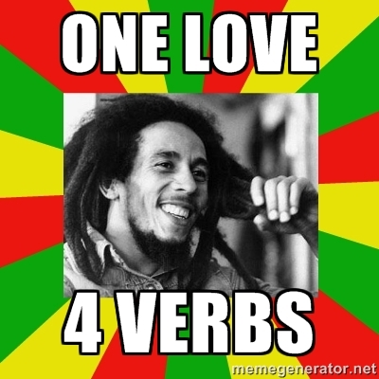
Pragmatist or RESTIFarian?

Slide 9
Pragmatic REST

Slide 10
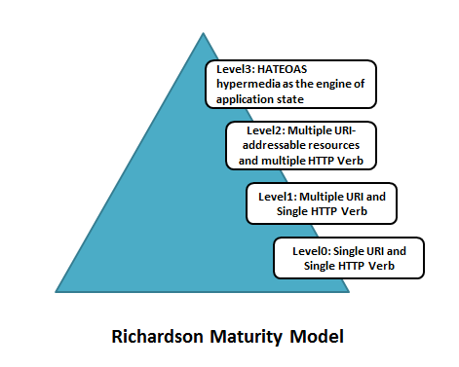
Notes:
Leonard Richardson’s REST Maturity Model

Slide 11
REST on HTTP
URIs are the resources
HTTP Verbs represent the behavior
HTTP Status Codes represent the state
Representations are returned from service calls
Content Negotiation determines the format of the Representation

Slide 12
HTTP Verbs
GET (Read)
Can be cached
Safe Operation (Idempotent)
POST (Create/Misc.)
Only Non-Idempotent verb
You can hide any action you want behind POST
PUT (Update)
Requests that the representation be stored at the URI
Idempotent
DELETE (Delete)
Requests that the representation be removed or made inaccessible
Idempotent

Slide 13
HTTP Status Codes
HTTP 200: OK
Use for GETs, DELETEs that return a body, PUTs
HTTP 201: Created
Use for when a POST Creates a new resource
HTTP 204: No Response
Use for when you want to return a success but the body is empty
HTTP 304: Not Modified
Use to tell the client that a cached resource has not been modified
HTTP 400: Bad Request
Use for any type of error the user can fix, such as validation. The request should be modified before it is sent again.
HTTP 401: Unauthorized
Use for when you don’t know who the user is or a user fails an authentication check
HTTP 403: Forbidden
The server understood the request, but refused to fulfil it. Use for authorization and denying certain actions.
HTTP 500: Server Error
The server had an unexpected error and couldn’t process the request. The user can try again later.

Slide 14
Representations
Collections and Instances
Format types: json/xml/html/images/csv/atom/etc..
Format can be determined by the mime type in Accept and Content-Type HTTP Headers
Mime type can help determine what to do with the representation
Why JSON?
Smaller footprint that XML
Easy to deserialize on nearly every platform
Simple
Flexible

Slide 15
RESTFul Resources vs SOAP
SOAP Call | HTTP Method |  | Rest Call | HTTP Method / Status Code
/GetDogs | POST |  | /dogs | GET / 200
/GetDog dogname=Casey | POST |  | /dogs/casey | GET / 200
/AddDog dogname=Casey | POST |  | /dogs {“dogname”: “Casey”} | POST / 201
/UpdateDog dogname=Rex | POST |  | /dogs/casey {“dogname”: “Rex”} | PUT / 200
/DeleteDog dogname=casey | POST |  | /dogs/casey | DELETE / 204
/FeedDog dogname=casey | POST |  | /dogs/casey {“feed”: true} | PUT / 200
 |  |  | Or
 |  |  | /dog/casey/feed | POST / 204
 |  |  | Or…

Slide 16
REST API Design Guidelines
Nouns that are plural instead of Verbs
Use the proper HTTP verbs
Use JSON as a default format unless you have a specific need for something different
Consider using jsonapi.org to help structure your json responses
Hide complexity behind the query string
Secure your API behind TLS/SSL
Authenticate your APIs
Forms based (Cookies) for browser apps
OAuth 2.0 for user based access
Token Based (HMAC) for service based access
Have a versioning strategy from the beginning
Use ISO 8601 for date formats
Provide documentation with code examples
Think about writing a SDK to make it easier for your developers on platforms you want to target

Slide 17
ASP.Net Web API

Slide 18
What is ASP.Net Web API?
A framework for building HTTP based services
Does not force a particular architectural style
Built on top of ASP.Net
Supports many MVC like features such as controllers, filters, routing, and dependency injection

Slide 19
What’s new in Web API v2?
Attribute based routing
IHttpActionResult
Testability Improvements
Built in CORS support
OWIN Self Hosting
OData Improvements

Slide 20
Demos!

Slide 21
Resources
Roy Fielding’s Dissertation:
http://www.ics.uci.edu/~fielding/pubs/dissertation/top.htm
Free eBook on API Design from Apigee:
http://apigee.com/about/content/web-api-design
Web API Design PluralsSight Course:
http://pluralsight.com/training/Courses/TableOfContents/web-api-design
Code from Demo:
https://github.com/elylucas/IssueTracker
Contact Me:
ely@meta-tek.net / @elylucas

